Slide 1
Systolic Blood Pressure Intervention Trial (SPRINT) Principal Results
Embargoed Until 2 p.m. ET, Monday, Nov. 9, 2015
Paul K. Whelton, MB, MD, MSc
Chair, SPRINT Steering Committee
Tulane University School of Public Health and Tropical Medicine, and School of Medicine
For the SPRINT Research Group

Slide 2
Background
Observational studies identify strong association between BP and risk of CVD, with no evidence of threshold for the relationship
High BP very common
High SBP leading risk factor for mortality and disability-adjusted life years
Worldwide, >1 billion adults have hypertension
Clinical trials demonstrate antihypertensive drug therapy reduces risk of CVD
However, optimal target for SBP lowering uncertain

Slide 3
SPRINT Research Question
Examine effect of more intensive high blood pressure treatment
than is currently recommended
Randomized Controlled Trial
Target Systolic BP
Intensive Treatment
Goal SBP < 120 mm Hg
Standard Treatment
Goal SBP < 140 mm Hg
SPRINT design details available at:
ClinicalTrials.gov (NCT01206062)
Ambrosius WT et al. Clin. Trials. 2014;11:532-546.

Slide 4
Major Inclusion Criteria
≥50 years old
Systolic blood pressure : 130 – 180 mm Hg (treated or untreated)
Additional cardiovascular disease (CVD) risk
Clinical or subclinical CVD (excluding stroke)
Chronic kidney disease (CKD), defined as eGFR 20 – <60 ml/min/1.73m²
Framingham Risk Score for 10-year CVD risk ≥ 15%
Age ≥ 75 years
At least one

Slide 5
Major Exclusion Criteria
Stroke
Diabetes mellitus
Polycystic kidney disease
Congestive heart failure (symptoms or EF < 35%)
Proteinuria >1g/d
CKD with eGFR < 20 mL/min/1.73m² (MDRD)
Adherence concerns

Slide 6
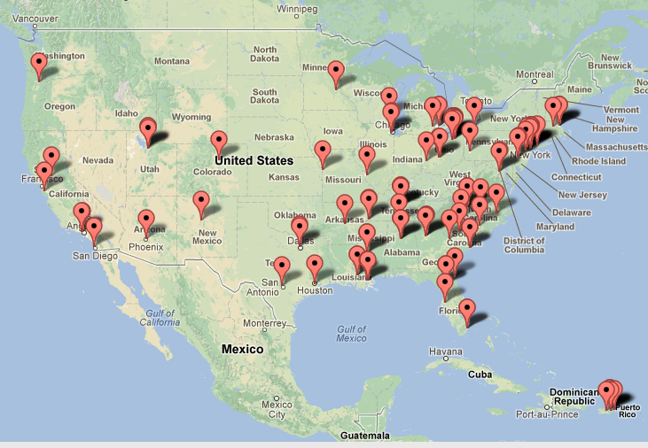
Location of 102 SPRINT Clinical Centers
Clinical Center Networks
-Ohio -Southeast -Utah -UAB -VA
Central Laboratory
MRI Reading Center
Project Office, NIH
Coordinating Center
Wake Forest School of Medicine
ECG Reading Center
Drug Distribution Center

Slide 7
SPRINT: Enrollment and Follow-up Experience
Randomized
(N=9,361)
Screened
(N=14,692)
Standard Treatment
(N=4,683)
Intensive Treatment
(N=4,678)
Consent withdrawn 224 242
Discontinued intervention 111 134
Lost to follow-up 154 121
Analyzed 4,678 4,683
(Intention to treat)
(Vital status assessment: entire cohort)

Slide 8
Demographic and Baseline Characteristics
 | Total N=9361 | Intensive N=4678 | Standard N=4683
Mean (SD) age, years | 67.9 (9.4) | 67.9 (9.4) | 67.9 (9.5)
% ≥75 years | 28.2% | 28.2% | 28.2%
Female, % | 35.6% | 36.0% | 35.2%
White, % | 57.7% | 57.7% | 57.7%
African-American, % | 29.9% | 29.5% | 30.4%
Hispanic, % | 10.5% | 10.8% | 10.3%
Prior CVD, % | 20.1% | 20.1% | 20.0%
Mean 10-year Framingham CVD risk, % | 20.1% | 20.1% | 20.1%
Taking antihypertensive meds, % | 90.6% | 90.8% | 90.4%
Mean (SD) number of antihypertensive meds | 1.8 (1.0) | 1.8 (1.0) | 1.8 (1.0)
Mean (SD) Baseline BP, mm Hg
Systolic | 139.7 (15.6) | 139.7 (15.8) | 139.7 (15.4)
Diastolic | 78.1 (11.9) | 78.2 (11.9) | 78.0 (12.0)

Slide 9
Selected Baseline Laboratory Characteristics
 | Total N=9361 | Intensive N=4678 | Standard N=4683
Mean (SD) eGFR, mL/min/1.73 m² | 71.7 (20.6) | 71.8 (20.7) | 71.7 (20.5)
% with eGFR<60 mL/min/1.73m² | 28.3 | 28.4 | 28.1
Mean (SD) Urine albumin/creatinine, mg/g | 42.6 (166.3) | 44.1 (178.7) | 41.1 (152.9)
Mean (SD) Total cholesterol, mg/dL | 190.1 (41.2) | 190.2 (41.4) | 190.0 (40.9)
Mean (SD) Fasting plasma glucose, mg/dL | 98.8 (13.5) | 98.8 (13.7) | 98.8 (13.4)

Slide 10
Pre-specified Subgroups of Special Interest
Age (<75 vs. ≥75 years)
Gender (Men vs. Women)
Race/ethnicity (African-American vs. Non African-American)
CKD (eGFR <60 vs. ≥60 mL/min/1.73m²)
CVD (CVD vs. no prior CVD)
Level of BP (Baseline SBP tertiles: ≤132, 133 to 144, ≥145 mm Hg)-

Slide 11
BP Intervention
BP monitored monthly for 3 months and every 3 months thereafter (additional visits could be scheduled)
Antihypertensive medication titration decisions based on mean BP
(3 readings at each visit), using a structured stepped-care approach
Agents from all major antihypertensive drug classes available free of charge
Periodic assessment for orthostatic hypotension and related symptoms

Slide 12
Primary Outcome and Primary Hypothesis
Primary outcome
CVD composite: first occurrence of
Myocardial infarction (MI)
Acute coronary syndrome (non-MI ACS)
Stroke
Acute decompensated heart failure (HF)
Cardiovascular disease death
Primary hypothesis*
CVD composite event rate lower in intensive compared to standard treatment
*Estimated power of 88.7% to detect a 20% difference
- based on recruitment of 9,250 participants, 4-6 years of follow-up and loss to follow-up of 2%/year.

Slide 13
Additional Outcomes
All-cause mortality
Primary outcome + all-cause mortality
Renal
Main secondary outcome:
Participants with CKD at baseline: incidence of decline in eGFR ≥50% or ESRD
Additional secondary outcomes:
Participants without CKD at baseline: incidence of decline in eGFR ≥30% (to <60 mL/min/1.73m²)
Participants with or without CKD at baseline: Incidence of albuminuria
Doubling of urinary
albumin/creatinine
(<10 to >10 mg/g)

Slide 14
Follow-up Assessment of Selected Measures
CVD outcomes
Pre-specified diagnostic criteria
Ascertainment method identical in both treatment arms
Structured interview every 3 months
Possible events adjudicated by a panel of experts, blinded to treatment assignment
Fatal events
Structured approach to collection of information
Cause of death adjudicated by the panel of experts, blinded to treatment assignment
Safety events
Could be reported at any SPRINT visit
Observers aware of treatment assignment
Labs: blood chemistries and urine albumin/creatinine

Slide 15
Decision to Stop BP Intervention
On August 20th, 2015, NHLBI Director accepted DSMB recommendation to inform SPRINT investigators and participants of CVD results
Concurrently, decision made to stop BP intervention
This presentation based on adjudicated events that occurred through August 20th, 2015
Median follow-up = 3.26 years
Data for some secondary non-CVD outcomes (e.g. dementia and cognitive impairment) being collected at final close-out visit and this process will be completed in 2016

Slide 16
Systolic BP During Follow-up
Year 1
Average SBP
(During Follow-up)
Standard: 134.6 mm Hg
Intensive: 121.5 mm Hg
Mean SBP
136.2 mm Hg
Standard
Mean SBP
121.4 mm Hg
Intensive
Average number of
antihypertensive
medications
Number of
participants

Slide 17
SPRINT Primary Outcome Cumulative Hazard
Hazard Ratio = 0.75 (95% CI: 0.64 to 0.89)
Standard
(319 events)
Intensive
(243 events)
During Trial (median follow-up = 3.26 years)
Number Needed to Treat (NNT)
to prevent a primary outcome = 61
Number of
Participants

Slide 18
SPRINT Primary Outcome and its Components Event Rates and Hazard Ratios
 | Intensive |  | Standard
 | No. of Events | Rate, %/year | No. of Events | Rate, %/year | HR (95% CI) | P value
Primary Outcome | 243 | 1.65 | 319 | 2.19 | 0.75 (0.64, 0.89) | <0.001
All MI | 97 | 0.65 | 116 | 0.78 | 0.83 (0.64, 1.09) | 0.19
Non-MI ACS | 40 | 0.27 | 40 | 0.27 | 1.00 (0.64, 1.55) | 0.99
All Stroke | 62 | 0.41 | 70 | 0.47 | 0.89 (0.63, 1.25) | 0.50
All HF | 62 | 0.41 | 100 | 0.67 | 0.62 (0.45, 0.84) | 0.002
CVD Death | 37 | 0.25 | 65 | 0.43 | 0.57 (0.38, 0.85) | 0.005

Slide 19
All-cause Mortality Cumulative Hazard
Hazard Ratio = 0.73 (95% CI: 0.60 to 0.90)
Standard
(155 deaths)
Adapt from Figure 2B in the N Engl J Med manuscript
Intensive
(210 deaths)
During Trial (median follow-up = 3.26 years)
Number Needed to Treat (NNT)
to Prevent a death = 90
Include NNT
Number of
Participants
Intensive

Slide 20
Primary Outcome Experience in the Six Pre-specified Subgroups of Interest
*Treatment by subgroup interaction

Slide 21
Renal Disease Outcomes
 |  | Intensive |  | Standard
 |  | Events | %/yr | Events | %/yr | HR (95% CI) | P
Participants with CKD at Baseline
 | Primary CKD outcome | 14 | 0.33 | 15 | 0.36 | 0.89 (0.42, 1.87) | 0.76
 | ≥50% reduction in eGFR* | 10 | 0.23 | 11 | 0.26 | 0.87 (0.36, 2.07) | 0.75
 | Dialysis | 6 | 0.14 | 10 | 0.24 | 0.57 (0.19, 1.54) | 0.27
 | Kidney transplant | 0 | - | 0 | - | - | .
 | Secondary CKD Outcome
 | Incident albuminuria** | 49 | 3.02 | 59 | 3.90 | 0.72 (0.48, 1.07) | 0.11
Participants without CKD at Baseline
 | Secondary CKD outcomes
 | ≥30% reduction in eGFR* | 127 | 1.21 | 37 | 0.35 | 3.48 (2.44, 5.10) | <.0001
 | Incident albuminuria** | 110 | 2.00 | 135 | 2.41 | 0.81 (0.63, 1.04) | 0.10
*Confirmed on a second occasion ≥90 days apart **Doubling of urinary albumin/creatinine ratio from <10 to >10 mg/g

Slide 22
Serious Adverse Events* (SAE) During Follow-up
All SAE reports | Number (%) of Participants
 | Intensive | Standard | HR (P Value)
 | 1793 (38.3) | 1736 (37.1) | 1.04 (0.25)
SAEs associated with Specific Conditions of Interest
Hypotension | 110 (2.4) | 66 (1.4) | 1.67 (0.001)
Syncope | 107 (2.3) | 80 (1.7) | 1.33 (0.05)
Injurious fall | 105 (2.2) | 110 (2.3) | 0.95 (0.71)
Bradycardia | 87 (1.9) | 73 (1.6) | 1.19 (0.28)
Electrolyte abnormality | 144 (3.1) | 107 (2.3) | 1.35 (0.020)
Acute kidney injury or acute renal failure | 193 (4.1) | 117 (2.5) | 1.66 (<0.001)
*Fatal or life threatening event, resulting in significant or persistent disability,
requiring or prolonging hospitalization, or judged important medical event.

Slide 23
Number (%) of Participants with a Monitored Clinical Measure During Follow-up
 | Number (%) of Participants
 | Intensive | Standard |  | HR (P Value)
Laboratory Measures¹
Sodium <130 mmol/L | 180 (3.9) |  | 100 (2.2) | 1.76 (<0.001)
Potassium <3.0 mmol/L | 114 (2.5) |  | 74 (1.6) | 1.50 (0.006)
Potassium >5.5 mmol/l | 176 (3.8) |  | 171 (3.7) | 1.00 (0.97)
Signs and Symptoms
Orthostatic hypotension² | 777 (16.6) |  | 857 (18.3) | 0.88 (0.013)
Orthostatic hypotension with dizziness | 62 (1.3) |  | 71 (1.5) | 0.85 (0.35)
1. Detected on routine or PRN labs; routine labs drawn quarterly for first year, then q 6 months
2. Drop in SBP ≥20 mmHg or DBP ≥10 mmHg 1 minute after standing (measured at 1, 6, and 12 months and yearly thereafter)

Slide 24
Summary and Conclusions
SPRINT examined effects of more intensive antihypertensive therapy than currently recommended
Participants were US adults ≥50 years with hypertension and additional risk for CVD
Rapid and sustained difference in SBP achieved between the two treatment arms
Trial stopped early, due to benefit, after median follow-up of 3.26 years
Incidence of primary outcome (composite of CVD events) 25% lower in Intensive compared to Standard Group and all-cause mortality reduced by 27%.
Treatment effect similar in all six pre-specified groups of interest.
The “number needed to treat” to prevent primary outcome event or death 61 and 90, respectively

Slide 25
Summary and Conclusions
In participants with CKD at baseline, no differences in renal outcomes
In participants without CKD at baseline, incidence of eGFR reduction ≥ 30% more common in Intensive Group
No overall difference in serious adverse events (SAEs) between treatment groups
SAEs associated with hypotension, syncope, electrolyte abnormalities, and hospital discharge reports of acute kidney injury or acute renal failure more common in Intensive Group
Overall, benefits of more intensive BP lowering exceeded the potential for harm

Slide 26
Acknowledgements
9,361 volunteers who agreed to participate in SPRINT
Investigators and staff, including Steering Committee, other principals at the 5 Clinical Center Networks, 102 participating Clinical Centers, Coordinating Center, Central Laboratory, ECG Reading Center, MRI Reading Center, and Drug Distribution Center
National Institutes of Health
National Heart, Lung, and Blood Institute (NHLBI)
National Institute of Diabetes and Digestive and Kidney Diseases (NIDDK)
National Institute on Aging (NIA)
National Institute of Neurological Disorders and Stroke (NINDS)
SPRINT Data and Safety Monitoring Board (DSMB)
Takeda and Arbor Pharmaceuticals (donated 5% of medication used)

Slide 27
Thank You
Additional details of the SPRINT principal results
The SPRINT Research Group
A Randomized Trial of Intensive versus Standard Blood-Pressure Control
N Engl J Med. DOI: 10.1056/NEJMoa 1511939
(simultaneous e publication)

Slide 28
Back-up Slides

Slide 29
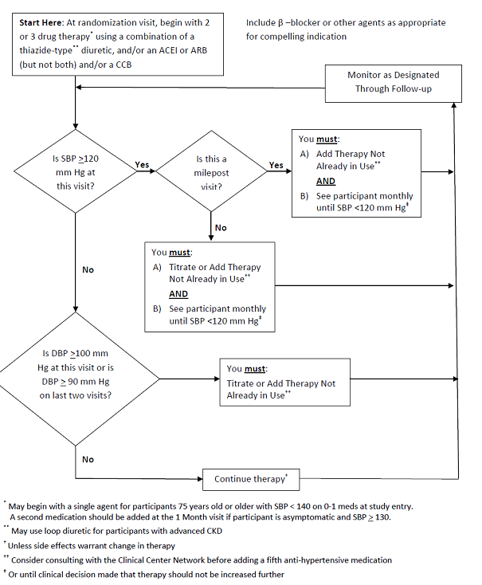
SPRINT
Treatment
Algorithm
Intensive
Treatment

Slide 30
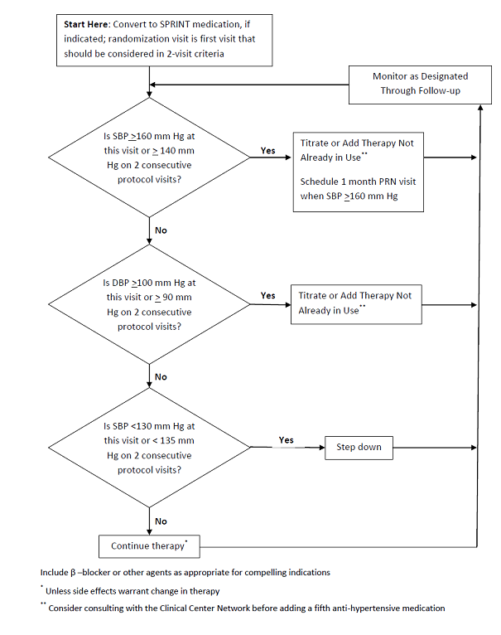
SPRINT
Treatment
Algorithm
Standard
Treatment

Slide 31
All-cause Mortality Experience in the Six Pre-specified Subgroups of Interest

